Slide 1


iMAP
January 27, 2023
CONTACT

Slide 2

2
CONTENTS
1. Introduction
4. Experimental Result
2. Related Work
5. Conclusion
3. iMAP

Slide 3
4
Introduction
The ideal Representation
1. Efficient: the memory capacity available used adaptively in response to scene size and complexity
2. Predictive: able to plausibly estimate the shape of regions not directly observed
3. Flexible: not needing a large amount of training data
or manual adjustment to run in a new scenario.

Slide 4
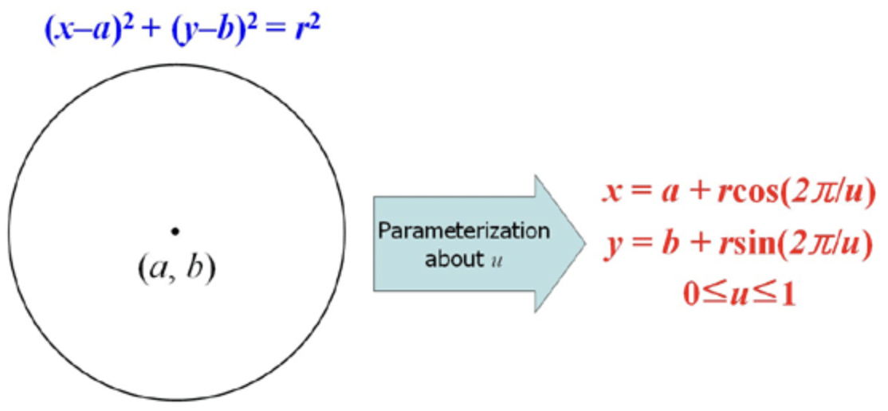
4
Introduction
Implicit neural representation
INR: A method of parameterizing all kinds of signals through a neural network
Even without prior training, the inherent priors present in the network structure allow it
to make watertight geometry estimates from partial data, and plausible completion of unobserved
region

Slide 5
4
Introduction
iMAP: designed with keyframe structure and multi-processing computation flow
tracking
iMAP
Tracking: align live RGB-D observation with rendered depth and colour predictions from the MLP scene map
Mapping
Mapping: select and maintains a set of historic keyframes whose viewpoints span the scene, and uses these to continually train and improve the MLP, while jointly optimizing the keyframe poses
Dynamically sample the most informative RGB-D pixels to reduce geometric uncertainty, achieving real-time speed

Slide 6
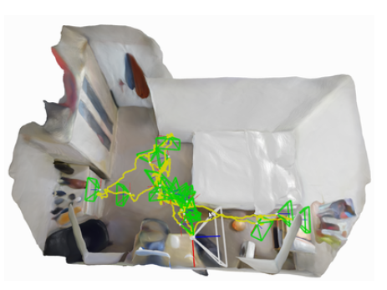
4
Introduction
Contribution
1. The first dense real-time SLAM system that uses an implicit neural scene representation and is capable of jointly optimizing a full 3D map and camera poses
2. The ability to incrementally train an implicit scene network in real-time, enabled by automated keyframe selection and loss guided sparse active sampling
3. A parallel implementation of our presented SLAM formulation which works online with a hand-held RGB-D camera

Slide 7
4
Related Work
Visual SLAM system
Dense SLAM
1. Standard representation for volume using occupancy or signed distance functions
Very expensive in term of memory if a fixed resolution is used.
2. Hierarchical approaches
Complicated to implement and usually offer only a small range of level of detail

Slide 8
4
Related Work
Implicit Scene Representation with MLPs
So far these methods have been considered as an offline tool, with computational requirements on the order of hours, days or weeks
When depth images are available, and when guided sparse sampling is used for rendering and training, these methods are suitable for real-time SLAM
Continual Learning
Plasticity (The ability to acquire new knowledge)
Stability (Preserving old knowledge)
1. Straightforward method: keyframes are automatically selected to store and compress past memories
2. loss-guided random sampling: periodically replay and strengthen previously-observed scene regions, while continuing to add information via new keyframes.

Slide 9
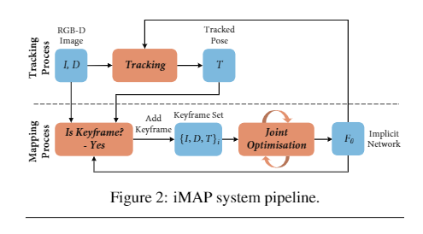
4
iMAP
System overview
1. 3D volumetric map is represented using a fully-connected neural network Fθ
2. render the colour and depth of a pixel by accumulating network queries from samples in a back-projected ray
3. Two processes run concurrently (Tracking + Mapping)

Slide 10
4
iMAP
Implicit Scene Neural Network
Input: (x, y, z)
output: (r, g, b, σ)
RGB
density
Gaussian positional enbedding: input의 position vector를 더해줘서 input들의 위치를 알 수 있게 해 줌

Slide 11


4
iMAP
Depth and colour Rendering
Input: (x, y, z)
output: (r, g, b, σ)
Depth value
Camera pose
Pixel coordinate
Camera intrinsic matrix

Slide 12
4
iMAP
Depth and colour Rendering
Input: (x, y, z)
output: (r, g, b, σ)
Depth value
Camera pose
Pixel coordinate
Camera intrinsic matrix

Slide 13

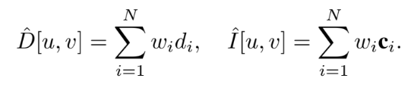



4
iMAP
Depth and colour Rendering
Input: (x, y, z)
output: (r, g, b, σ)

Slide 14
4
iMAP
Depth and colour Rendering
Input: (x, y, z)
output: (r, g, b, σ)

Slide 15
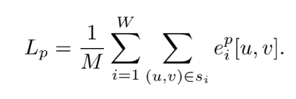
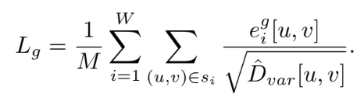

4
iMAP
Joint Optimisation
Optimisation:

Slide 16
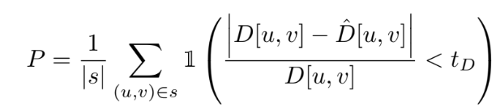
4
iMAP
Keyframe Selection
Jointly optimizing the network parameters and camera poses using all images from a video is not computationally feasible

Slide 17
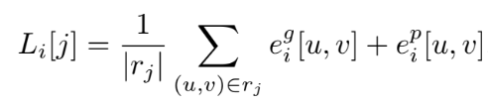
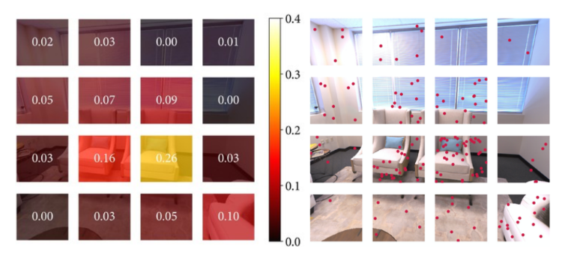
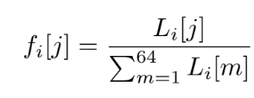
4
iMAP
Active Sampling: image activate sampling

Slide 18
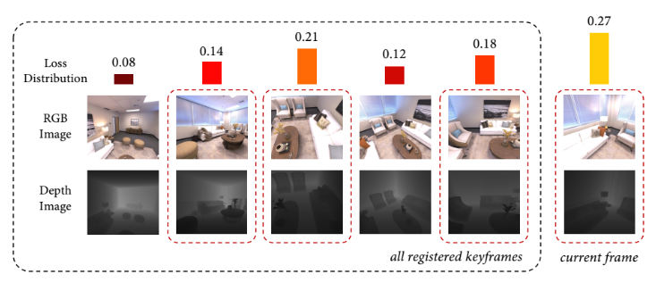
4
iMAP
Active Sampling: Bounded keyframe selection
To bound joint optimisation computation, we choose a fixed number (3 in the live system) of keyframes at each iteration, randomly sampled according to the loss distribution.

Slide 19
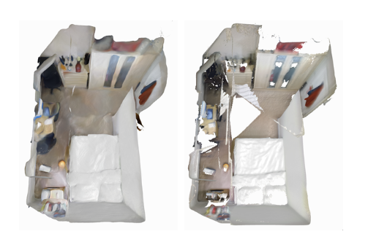
4
Experimental Results
Accuracy(cm): average distance between sampled points
from the reconstructed mesh and the nearest ground-truth point
Completion (cm): the average distance between sampled points
from the ground-truth mesh and the nearest reconstructed
Completion Ratio(<5cm %): the percentage of points
in the reconstructed mesh with Completion under 5 cm.

Slide 20
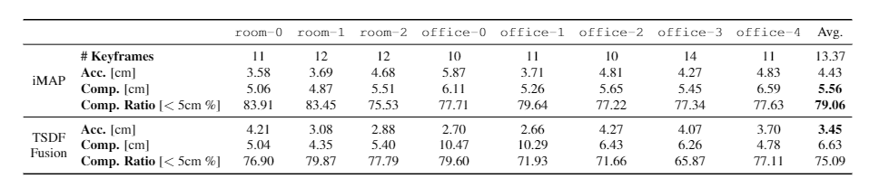
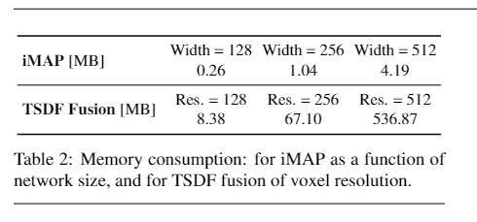
4
Experimental Results

Slide 21
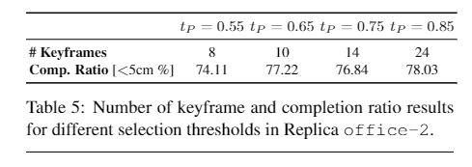
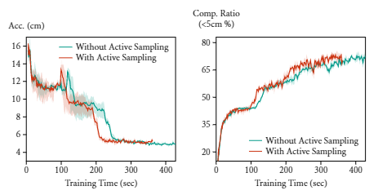
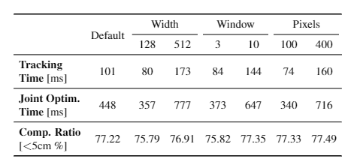
4
Experimental Results

Slide 22
4
Conclusion
The keys to the real-time: parallel tracking and mapping, loss-guided pixel sampling for rapid optimisation, and intelligent keyframe selection as replay to avoid network forgetting.

Slide 23
THANK YOU

